Slide 1
Chris Gagnon Outreach Coordinator 360-725-3131 Christina.Gagnon@commerce.wa.gov

Slide 2
Achieving a Better Life Experience
What is ABLE?
Result of the Stephen Beck, Jr. Achieving a Better Life Experience Act 2014
Eliminates $2,000 asset limit and spend down issues
Tax-advantaged savings accounts for people with disabilities (mental health, physical, developmental, congenital, and more)
Contribute up to $15,000 a year without impacting eligibility for certain means-tested disability benefits
Washington - nearing 2,000 accounts / $12M assets

Slide 3
Disability onset before age 26
Who is Eligible?
Is entitled to Supplemental Security Income (SSI) or Social Security Disability Insurance (SSDI) benefits based on blindness or disability
or
Self-certifies that they have a qualifying disability diagnosis from a physician
washingtonstateable.com/assets/docs/washington-able-physician-form.pdf

Slide 4
How Does it Work?
1. Open an account
Pick a cash option and/or investment option
Add $25 (bank account is securely connected to your ABLE account)
2. Withdraw money (online from your ABLE account to your bank account, or optional ABLE debit card)
3. Contribute money ($15,000 annual contribution limit from all sources)
Account limits: $100,000 SSI; $500,000 not on SSI

Slide 5
Qualified Expenses
Make it Explainable & Defendable
Keep Receipts & Good Records
Expenses which help improve health, independence, and/or quality of life
Basic Living Expenses | Housing | Transportation | Education | Assistive Technology
Employment Training | Personal Support Services | Legal Fees, Funeral, Burial | Health & Wellness | Financial Management
Notes:
If ABLE $ is held aside for a future order, must be able to document that.
If ABLE $ is set aside to pay rent, use it that same month
IRS Proposed ABLE Rules 2015 – page 24 conclude that the term “qualified disability expenses” should be broadly construed to permit the inclusion of basic living. Basic food purchases are eligible.

Slide 6
SSI Implications
Balances over $100,000 count as a resource
SSI suspended (not terminated)
No affect to Medicaid benefits
If you hold on to the money from one calendar month to the next, then housing expenditures and non-qualified expenditures count as resources
Note: Beneficiary’s own wages still count as income even if contributed to a Washington ABLE account
Notes:
Even if balance is over $100,000 there is no change to Medicaid (Apple Health) for the beneficiary
A balance of $103,000 counts as $3,000 towards the resource limit
SSI monthly cash benefit reinstated when ABLE balance goes below $100,000

Slide 7
What Are the Benefits?
Flexible
Easy to use and manage account
Tax-advantaged
Earnings grow free from federal taxes
Doesn’t impact benefits
ABLE funds are disregarded when determining eligibility for certain means-tested benefits
For SSI, an account balance up to $100,000 is disregarded
Eliminates spend-down issues
≠ 401(k) – employer
≠ 403(b) – employer
≠ IRA – Roth $5K/yr.
ABLE → $15K/yr.

Slide 8
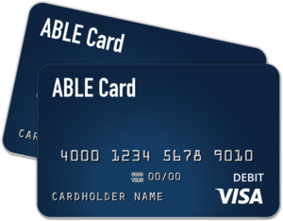
True Link ABLE Card
Debit Card
Optional - $1.25/month
Pre-loaded - load up to $20,000
Transactions tracked online
FDIC insured
Cannot be used for cash or at ATMs

Slide 9
Anyone can contribute!
ABLE Gift Contributions
Account owner sets up gifting page
Shares link with family & friends, posts to social media
Allows contributions online or by mail
$15,000 annual contribution limit still applies
https://www.washingtonstateable.com/faqs/category/Gifting

Slide 10
ABLE Investment Options
Conservative | Moderate | Aggressive
ABLE Conservative seeks to provide current income and some growth by investing in a ABLE Conservative seeks to provide current income and some growth by investing in a portfolio of mutual funds that consists of 20% global public stocks and 80% bonds. Overall, there’s a small amount of risk and limited appreciation potential, designed for a shorter investment period. | ABLE Moderate seeks to provide a combination of growth and current income by investing in a portfolio of mutual funds that consists of 50% global public stocks and 50% bonds. Overall, there’s a medium level of risk for a pursuit of investment return, designed for a medium or uncertain time horizon. | ABLE Aggressive provides the potential to grow by investing in a portfolio of mutual funds that consists of 84% global public stocks and 16% bonds. Overall, there’s a higher level or risk and potential for return (or loss), designed for a longer investment period (10 years or more).
Stocks Bonds
Stocks Bonds
Stocks Bonds
Notes:
3 Investment Options – Conservative, Moderate and Aggressive
Can use savings program only

Slide 11
Account Costs
No enrollment fee
$25 initial contribution at time of set-up
Annual $35 maintenance fee
Monthly $1.25 fee for debit card
Investment fees - 0.30 – 0.38%
Miscellaneous fees

Slide 12
ABLE Updates
ABLE to Work Act –
If working, may contribute an additional amount equal to current year gross income — up to $12,490
Eligible only if beneficiary or employer is NOT contributing to a defined contribution plan
Payroll Deduction
Entity/Organizational Authorized Legal Representative
IRS Final Rules – stay tuned!
https://www.irs.gov/retirement-plans/plan-participant-employee/retirement-savings-contributions-savers-credit

Slide 13
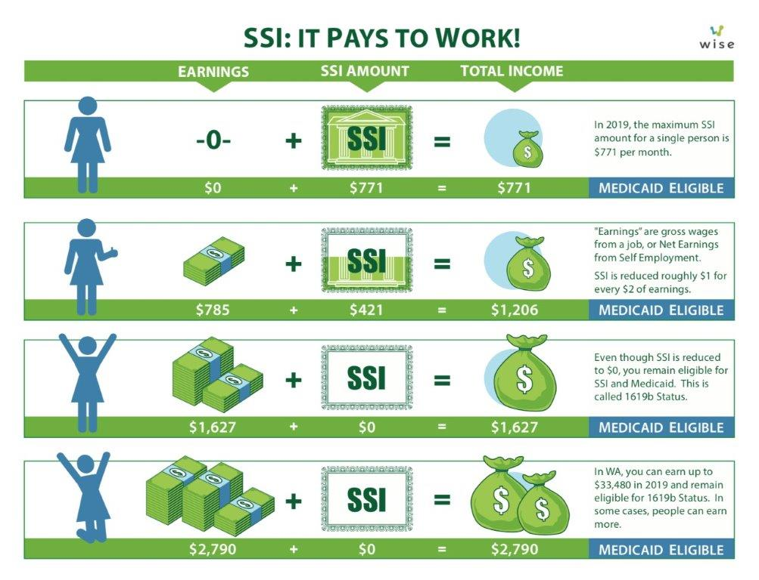
SSI: It pays to work!
Notes:
This is a good graphic for what our programs do – higher quality of life with better opportunities
For SSI (DVR) and LNI - getting people working or injured folks back to work is best for the employee in the long run
For an injured worker or worker with a disability – employers and benefit agencies want to help get employees back to work or working in a new position complimentary to the worker’s new reality
For an employer taking on new folks or realizing existing employees are aging and their abilities changing as they age, ABLE and DDETF can help – whether or not SSI is involved

Slide 14
What do you need to set up your own account?
Start Saving – washingtonstateable.com
Name, address, date of birth
Social security number
Bank account information
$25 to set up account
Who can set up an account for someone else?
For a minor (under 18):
Parent or legal guardian
For an adult (18 and over):
Power of Attorney, or Legal Guardianship or Conservatorship
What do you need to set up an account
for someone else?
Name, address, date of birth for account owner & yourself
Social security number for account owner & yourself
Bank account information
$25 to set up account

Slide 15
YouTube How-to Videos!
WAStateABLE

Slide 16
ABLE Exemptions
HCA Apple Health
Permanent rule filed. ABLE exempt.
DSHS SNAP, TANF, etc.
Permanent rules filed. ABLE exempt.
Social Security Administration
POMS SI 01130.740. ABLE exempt.
HUD Section 8 (Housing)
PIH 2019-09 issued April 26th. ABLE exempt.
Notes:
ABLE
capped so cannot accept large lump sums
3rd party contributions go to Medicaid recovery
ABLE is not a trust
Beneficiaries in charge of their accounts
Bond requirement for guardians if over $3k
DDETF
cannot pay for shelter costs if beneficiary collects SSI
3rd party contributions exempted from Medicaid recovery
Higher costs because of work of trust manager to manage beneficiary’s withdrawals
State matches fees to offset costs for low balance accounts (and capped for high balance accounts)

Slide 17
Recap
Sign up / manage account online
People older than age 26 can open an account
Disability onset prior to age 26
Washington resident
$15,000 cap on annual contributions unless qualify for ABLE to Work
Anyone may contribute
$100,000 account limit if receiving SSI; $500,000 if NOT
Washingtonstateable.com/faqs &
Ablenrc.org

Slide 18
Two programs that can be used together
Notes:
ABLE
capped so cannot accept large lump sums
3rd party contributions go to Medicaid recovery
ABLE is not a trust
Beneficiaries in charge of their accounts
Bond requirement for guardians if over $3k
DDETF
cannot pay for shelter costs if beneficiary collects SSI
3rd party contributions exempted from Medicaid recovery
Higher costs because of work of trust manager to manage beneficiary’s withdrawals
State matches fees to offset costs for low balance accounts (and capped for high balance accounts)

Slide 19
Thank You!
washingtonstateable.com/
1-844-600-2253 from 9am–5pm
1-844-888-2253 (TTY)
Facebook @WAStateABLE
Twitter @wa_able
YouTube https://www.youtube.com/channel/UCBSI5MmR7b6nwjgsKoByT6g

